Slide 1

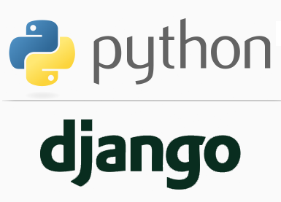
FULL STACK WEB DEVELOPMENT WITH DJANGO
Lecture 3

Slide 2

Today’s Agenda
Installing Django
Setting Up The System
Creating Virtual Environment
Installing And Testing Django

Slide 3
Setting Up The System
Before we can start learning the Django Framework, we must install some softwares on our computer.
Fortunately, this is a simple three step process:
Install Python
Install a Python Virtual Environment
Install Django within the Virtual Environment.

Slide 4
Installing Python
We are using Python 3.10 in this course which is the latest Python version and we have already installed it .
To check the current installed version of Python we can type the command python --version at the command prompt.

Slide 5
What Is A Virtual Environment ?
When we install Python we get a single global environment that is shared by all our Python projects/codes.
Now , we know that Python doesn’t come with all packages preinstalled. There are certain 3rd party packages which are not bundled with Python
For example , packages like cx_Oracle , SpeechRec , PyGame etc are not a part of default Python installation.

Slide 6
What Is A Virtual Environment ?
So we will have to download and install them separately using pip command
For example: pip install cx_oracle
While we can install whatever Python packages we like in the environment, but we can only install one particular version of each package at a time.
AND THIS CAN CREATE A PROBLEM!!

Slide 7
What Is A Virtual Environment ?
To understand this , assume that we have created a Python project called “Mouzikka” for playing songs.
In this project we have used PyGame library with version 1.9.4.
Now suppose in future we are developing another project but it requires a new version of PyGame library called 2.0

Slide 8
What Is A Virtual Environment ?
Now if we install/upgrade the PyGame 2.0 package globally , then it will replace the current package PyGame 1.9.4 and due to this our previous project “Mouzikka” might stop working as some functions in the PyGame 2.0 might have changed.
So we will require both the versions of PyGame i.e. PyGame 1.9.4 for our previous project “Mouzikka” and PyGame 2.0 for our new project.

Slide 9
What Is A Virtual Environment ?
This is only possible using “Virtual Environments”
So , a virtual environment is a tool to maintain separate space for a project with its dependencies and libraries in one place.
This environment is specific to the particular project and doesn't interfere with other projects' dependencies.

Slide 10
What Is A Virtual Environment ?
Same concept also applies to Django .
If we install Django into the default/global environment then we will only be able to target just one version of Django on our computer.
This can be a problem if we want to create new websites (using the latest version of Django) while still maintaining websites that rely on older versions.

Slide 11
What Is A Virtual Environment ?
As a result, experienced Django developers typically run Django apps within independent Virtual environments.
This enables multiple different Django environments on a single computer.

Slide 12
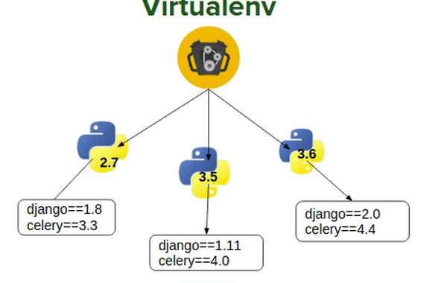
What Is A Virtual Environment ?

Slide 13
What Is A Virtual Environment ?
So finally we can say that a virtual environment is a way for us to have multiple versions of Python/Django on a single computer without them clashing with each other.
Each version can be considered as a separate development environment and we can have different versions of Python libraries and modules all isolated from one another.

Slide 14
Creating The Project Directory
Before we create our virtual environment, we first need to create a project folder that will house not only our virtual environment, but all the code and media for our Django application.
The project folder can go anywhere on our computer.

Slide 15
Creating The Project Directory
We are creating it in D:\djangoexamples by the name myfirstproject.
So the complete path is D:\djangoexamples\myfirstproject

Slide 16
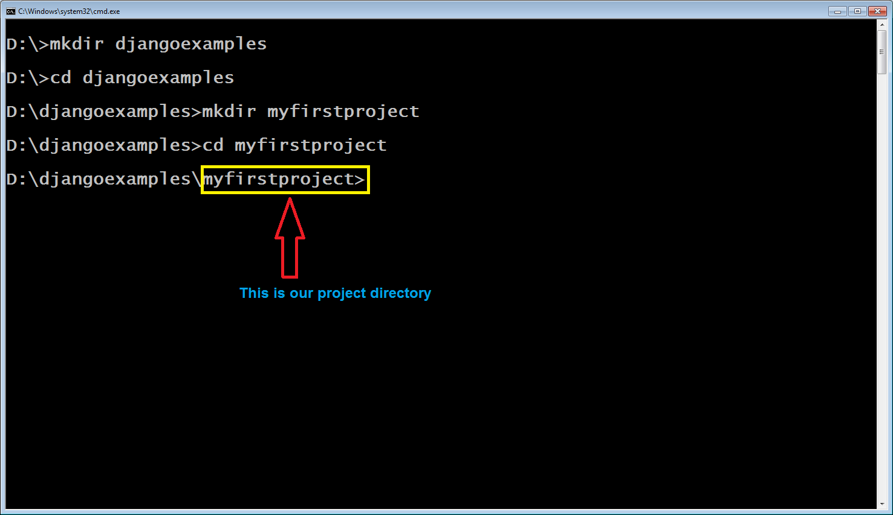
Creating The Project Directory

Slide 17
Creating The Virtual Environment
As previously discussed , a virtual environment is an isolated Python environment which allows us to use different package versions for different projects.
To create a virtual environment , we need a tool called virtualenv .
So first we should install this tool using pip command inside our project directory called myfirstproject
The command to do this is :
pip install virtualenv

Slide 18
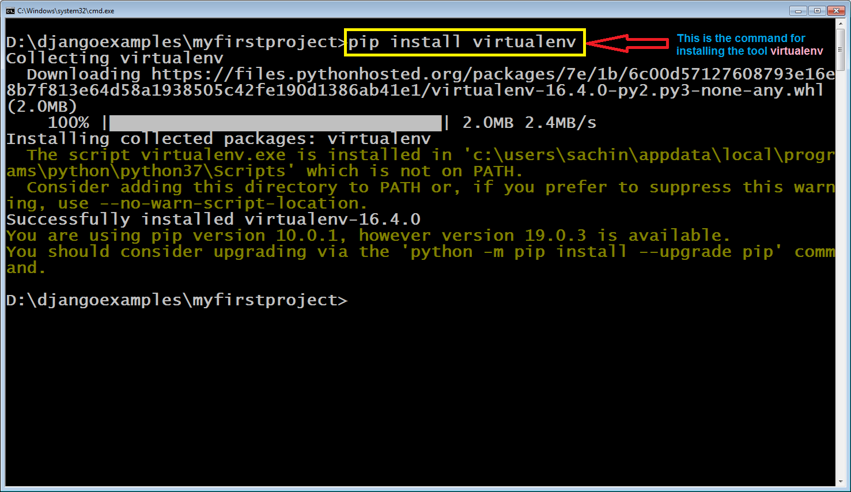
Creating The Virtual Environment

Slide 19
Updating pip
If we closely observe the previous screenshot , we will find that Python is suggesting us to upgrade our pip tool.
Pip gets updated more frequently than Python , so it is always a good practice to keep the latest version of pip installed on our machine

Slide 20
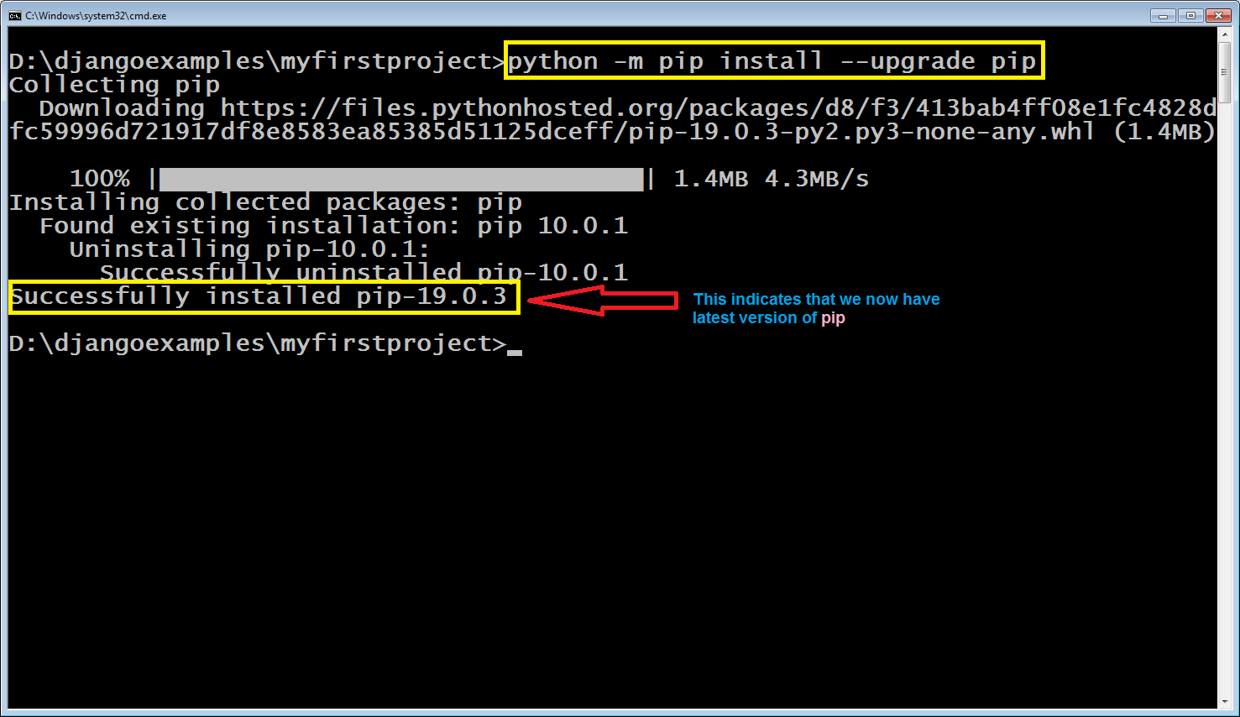
Updating pip
Move to your project directory myfirstproject and type the following command:
python –m pip install –upgrade pip

Slide 21
Creating The Virtual Environment
After installing the tool virtualenv , we must now create our virtual environment.
The steps to do that will be:
Go to the project directory myfirstproject
Type the command : virtualenv some_name
For example: virtualenv myenv
This is the name of the
virtual environment and it could be
any name

Slide 22
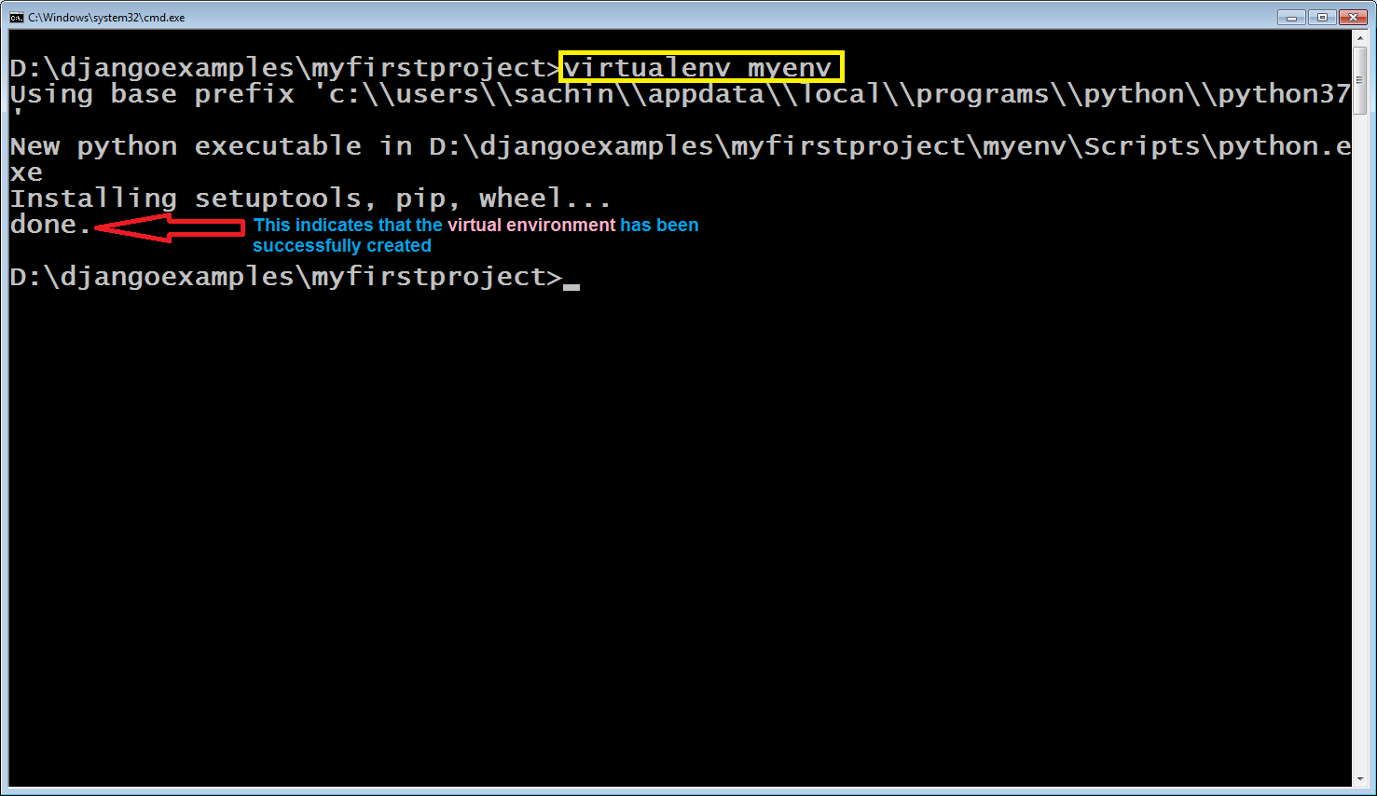
Creating The Virtual Environment

Slide 23
Activating The Virtual Environment
To put virtual environment in action we must activate it so that whatever we install after this gets installed in the virtual environment and not globally.
The steps to activate the virtual environment are:
Go to the project directory myfirstproject
Type the command : name of virt env\scripts\activate
For example: myenv\scripts\activate
This is the name of the
virtual environment
as given by us.
This is the name of the
batch file that will
activate the
virtual environment.

Slide 24
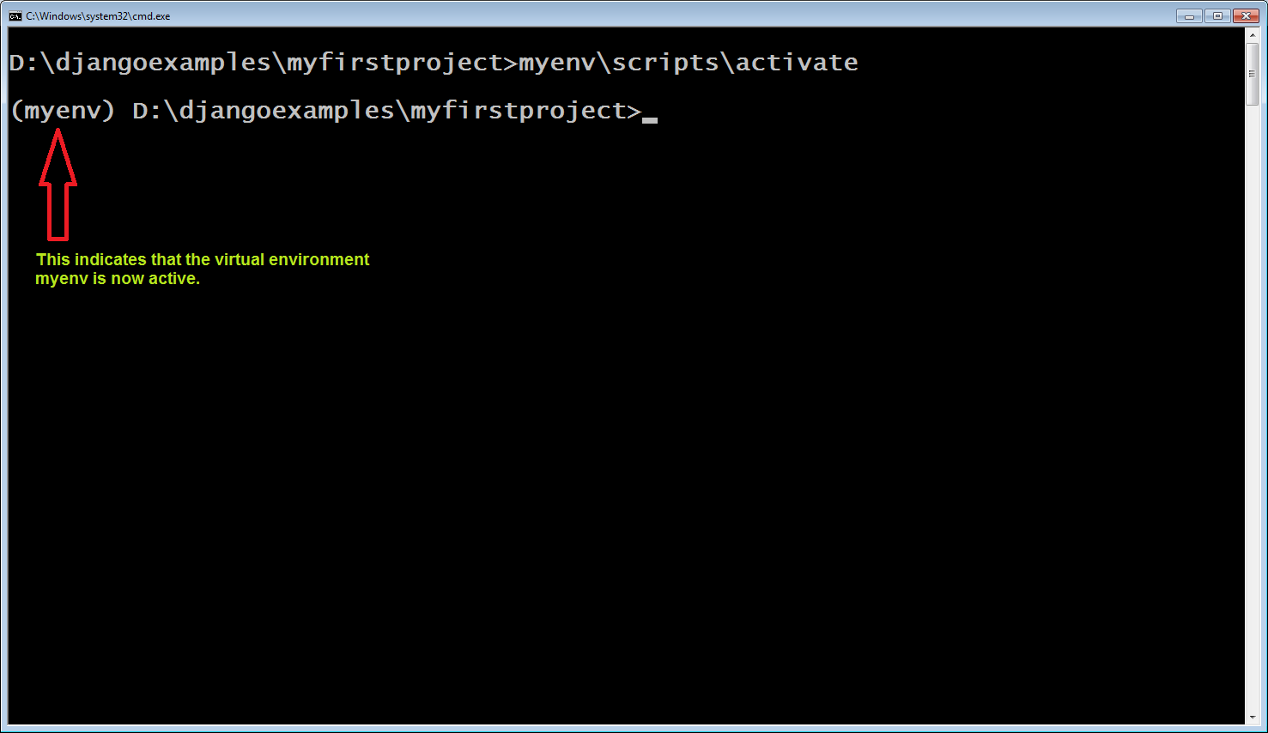
Activating The Virtual Environment

Slide 25
Deactivating The Virtual Environment
We also can deactivate the virtual environment at any point of time
The steps to deactivate the virtual environment are:
Go to the project directory myfirstproject
Type the command : name of virt env\scripts\deactivate
For example: myenv\scripts\deactivate
This is the name of the
batch file that will deactivate the
virtual environment.

Slide 26
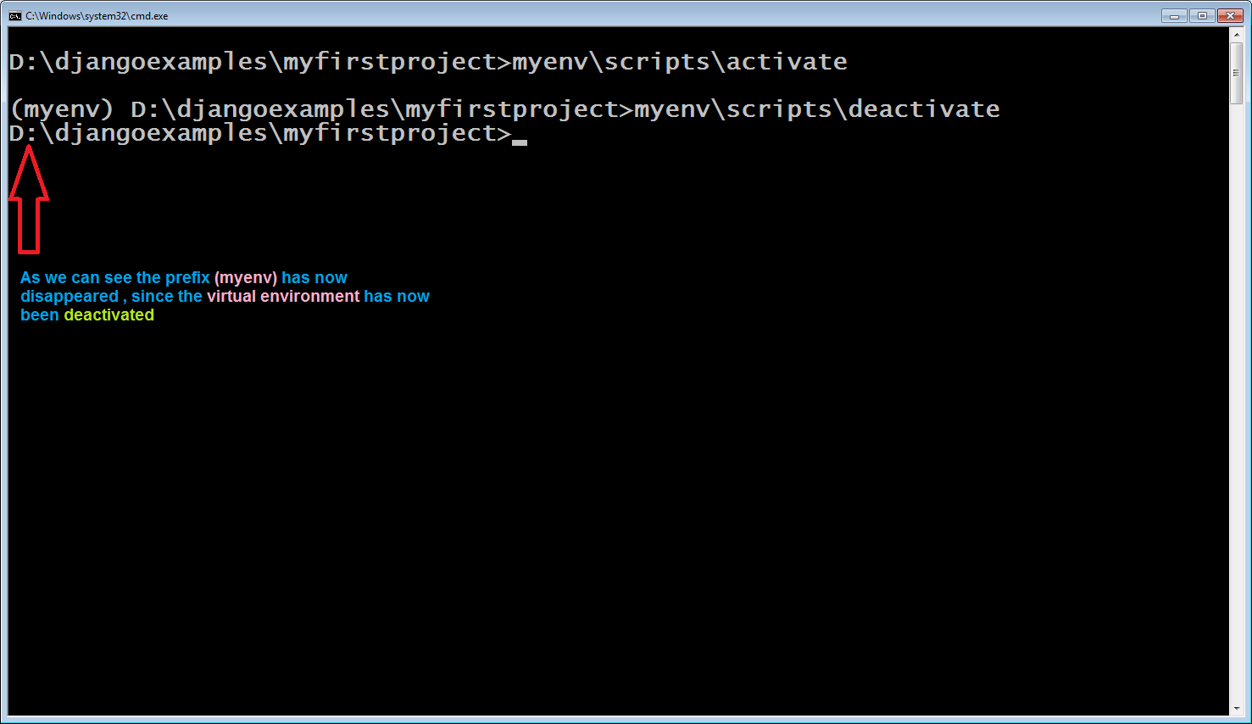
Deactivating The Virtual Environment

Slide 27
Installing Django
Now that we have Python installed and are running a virtual environment, installing Django is super easy.
The steps to install Django are:
Go to the project directory myfirstproject and make sure that virtual environment myenv is active
Now type the command : pip install django
This will install the latest version of Django .
However we also can install a particular
Django version by using == . For example
pip instal django==1.1.5

Slide 28
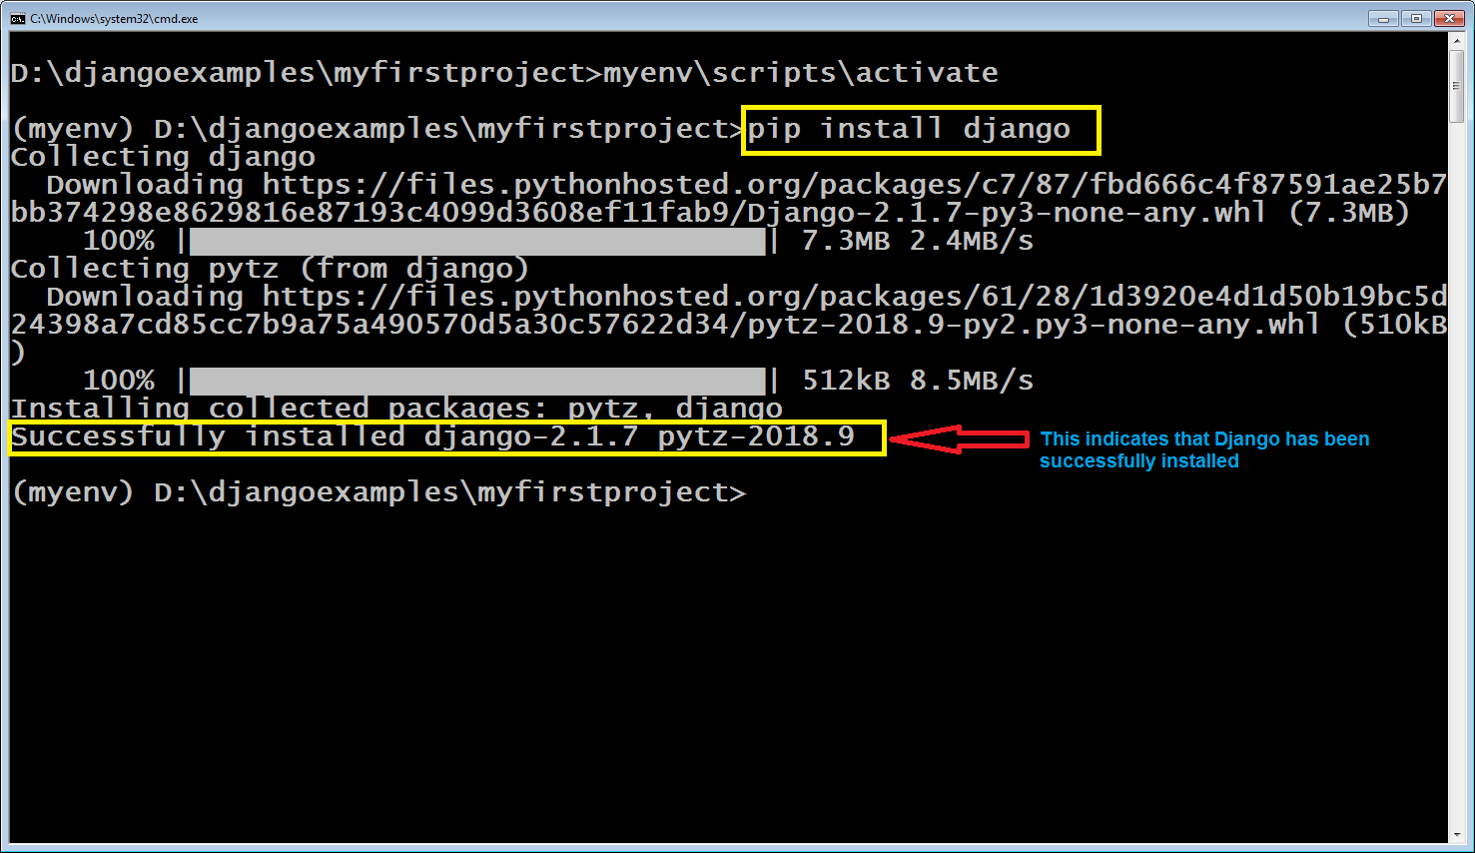
Installing Django

Slide 29
Testing The Installation
We can test whether Django has been properly installed or not in 2 ways:
Using the Python Interactive Shell
Using directly the command prompt

Slide 30
Testing The Installation
To use interactive shell do the following:
Go to your virtual environment command prompt.
Start the Python interactive interpreter by typing python and hitting Enter.
Now type the following code:
import django
django.get_version()
The output will be the current version of Django which is installed in the virtual environment

Slide 31
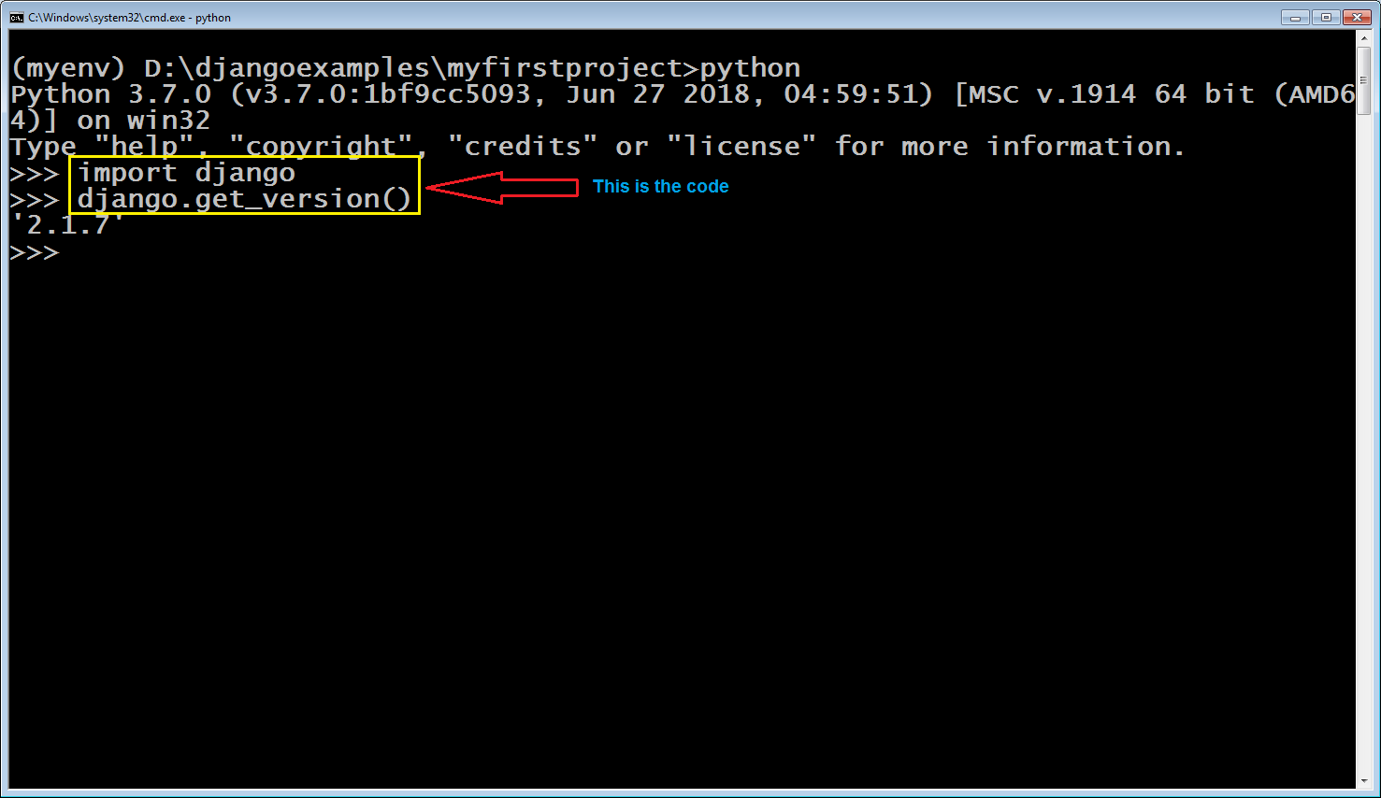
Testing The Installation

Slide 32
Testing The Installation
To check the installation using command prompt , do the following:
Go to your virtual environment command prompt.
Type the following command: python –m django --version
The output will be the current version of Django which is installed in the virtual environment

Slide 33
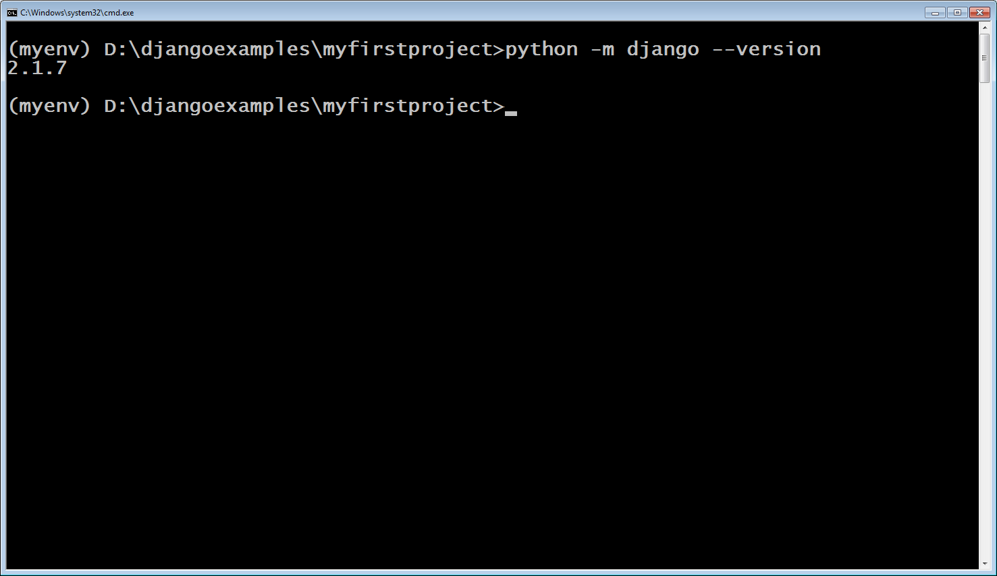
Testing The Installation

